Slide 1
Reliable Facility Location Problem
——Wenxing Lan

Slide 2
Outline:
Introduction to RFLP
EA with Memorable Local Search (EAMLS)
Reproduction Result of EAMLS
My Initialization Method
Experimental Result
Conclusion

Slide 3

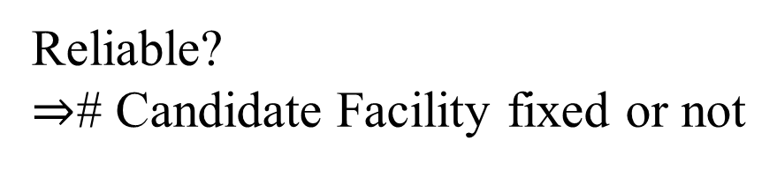
Introduction to RFLP:
Reliable?
$⇒$# Candidate Facility fixed or not
# Candidate Facility
Position of Candidate Facility

Slide 4
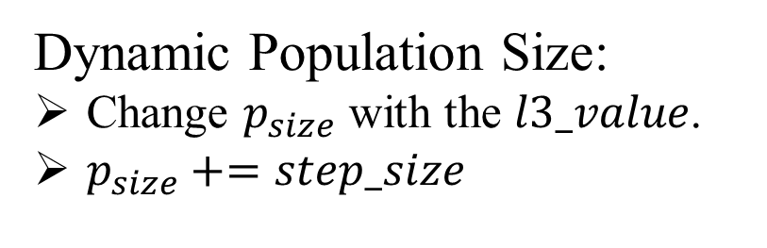
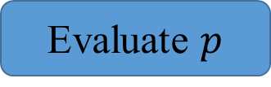
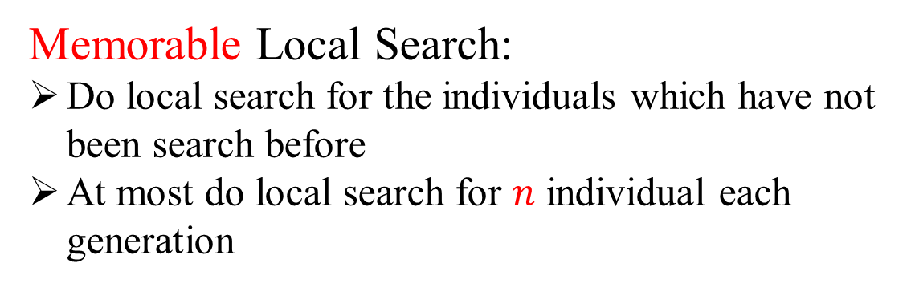
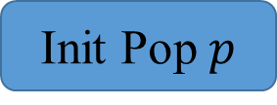
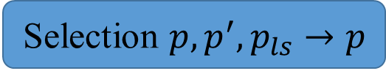
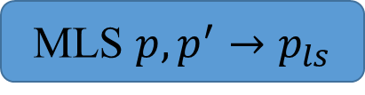
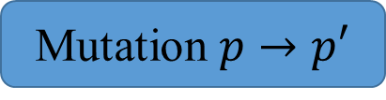
EAMLS:
Initialization Method:
Stochastic initialization
Binary Representation
Every gene of an individual takes 0 or 1 with equal probability
Init Pop $p$
Evaluate $p$
Memorable Local Search:
Do local search for the individuals which have not been search before
At most do local search for $n$ individual each generation
Mutation $p→p′$
# Generation < G
MLS $p,p^{′}→p_{ls}$
Selection $p,p^{′},p_{ls}→p$
Dynamic Population Size:
Change $p_{size}$ with the $l3_value$.
$p_{size}+=step_size$
Output Best Solution
[1] H. Zhang, J. Liu, and X. Yao, “A hybrid evolutionary algorithm for reliable facility location problem,” in Parallel Problem Solving from Nature – PPSN XVI, T. B¨ack, M. Preuss, A. Deutz, H. Wang, C. Doerr, M. Emmerich, and H. Trautmann, Eds. Cham: Springer International Publishing, 2020, pp. 454–467.

Slide 5
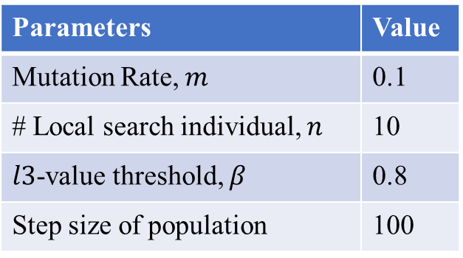
Reproduction Result of EAMLS:
Runtime Environment:
All programs have been written in C++ 11 and executed on an Intel(R) Core(TM) i5-10400F CPU working at 2.90 GHz on Windows 10 20H2, using a single thread.
Parameters Setting (Same as ones in [1]):
Parameters | Value
Mutation Rate, $m$ | 0.1
# Local search individual, $n$ | 10
$l3$-value threshold, $β$ | 0.8
Step size of population | 100
Instance Scale (# nodes) | # Generation | Population Size
10 | 10 | 20
50 | 20 | 20
100 | 50 | 100
Wilcox Sign Rank test is done with the level of significance 0.05.
[1] H. Zhang, J. Liu, and X. Yao, “A hybrid evolutionary algorithm for reliable facility location problem,” in Parallel Problem Solving from Nature – PPSN XVI, T. B¨ack, M. Preuss, A. Deutz, H. Wang, C. Doerr, M. Emmerich, and H. Trautmann, Eds. Cham: Springer International Publishing, 2020, pp. 454–467.

Slide 6
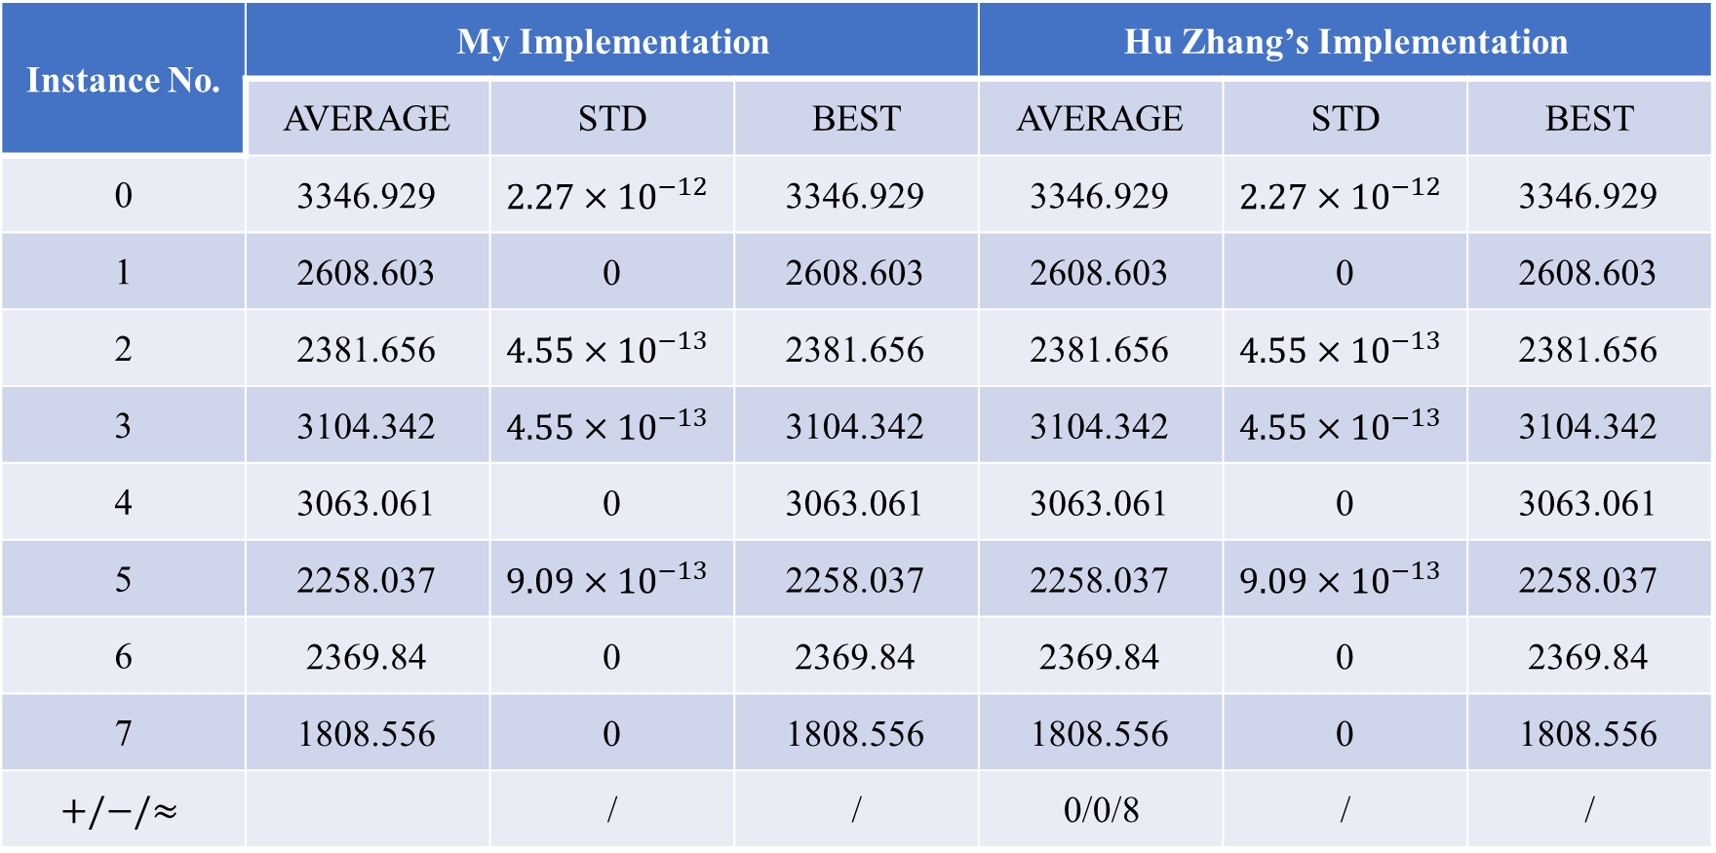
Reproduction Result of EAMLS:
10 nodes instances:
Instance No. | My Implementation |  |  | Hu Zhang’s Implementation
 | AVERAGE | STD | BEST | AVERAGE | STD | BEST
0 | 3346.929 | $$2.27×{10}^{−12}$$ | 3346.929 | 3346.929 | $$2.27×{10}^{−12}$$ | 3346.929
1 | 2608.603 | 0 | 2608.603 | 2608.603 | 0 | 2608.603
2 | 2381.656 | $$4.55×{10}^{−13}$$ | 2381.656 | 2381.656 | $$4.55×{10}^{−13}$$ | 2381.656
3 | 3104.342 | $$4.55×{10}^{−13}$$ | 3104.342 | 3104.342 | $$4.55×{10}^{−13}$$ | 3104.342
4 | 3063.061 | 0 | 3063.061 | 3063.061 | 0 | 3063.061
5 | 2258.037 | $$9.09×{10}^{−13}$$ | 2258.037 | 2258.037 | $$9.09×{10}^{−13}$$ | 2258.037
6 | 2369.84 | 0 | 2369.84 | 2369.84 | 0 | 2369.84
7 | 1808.556 | 0 | 1808.556 | 1808.556 | 0 | 1808.556
$$+/−/≈$$ |  | / | / | 0/0/8 | / | /

Slide 7
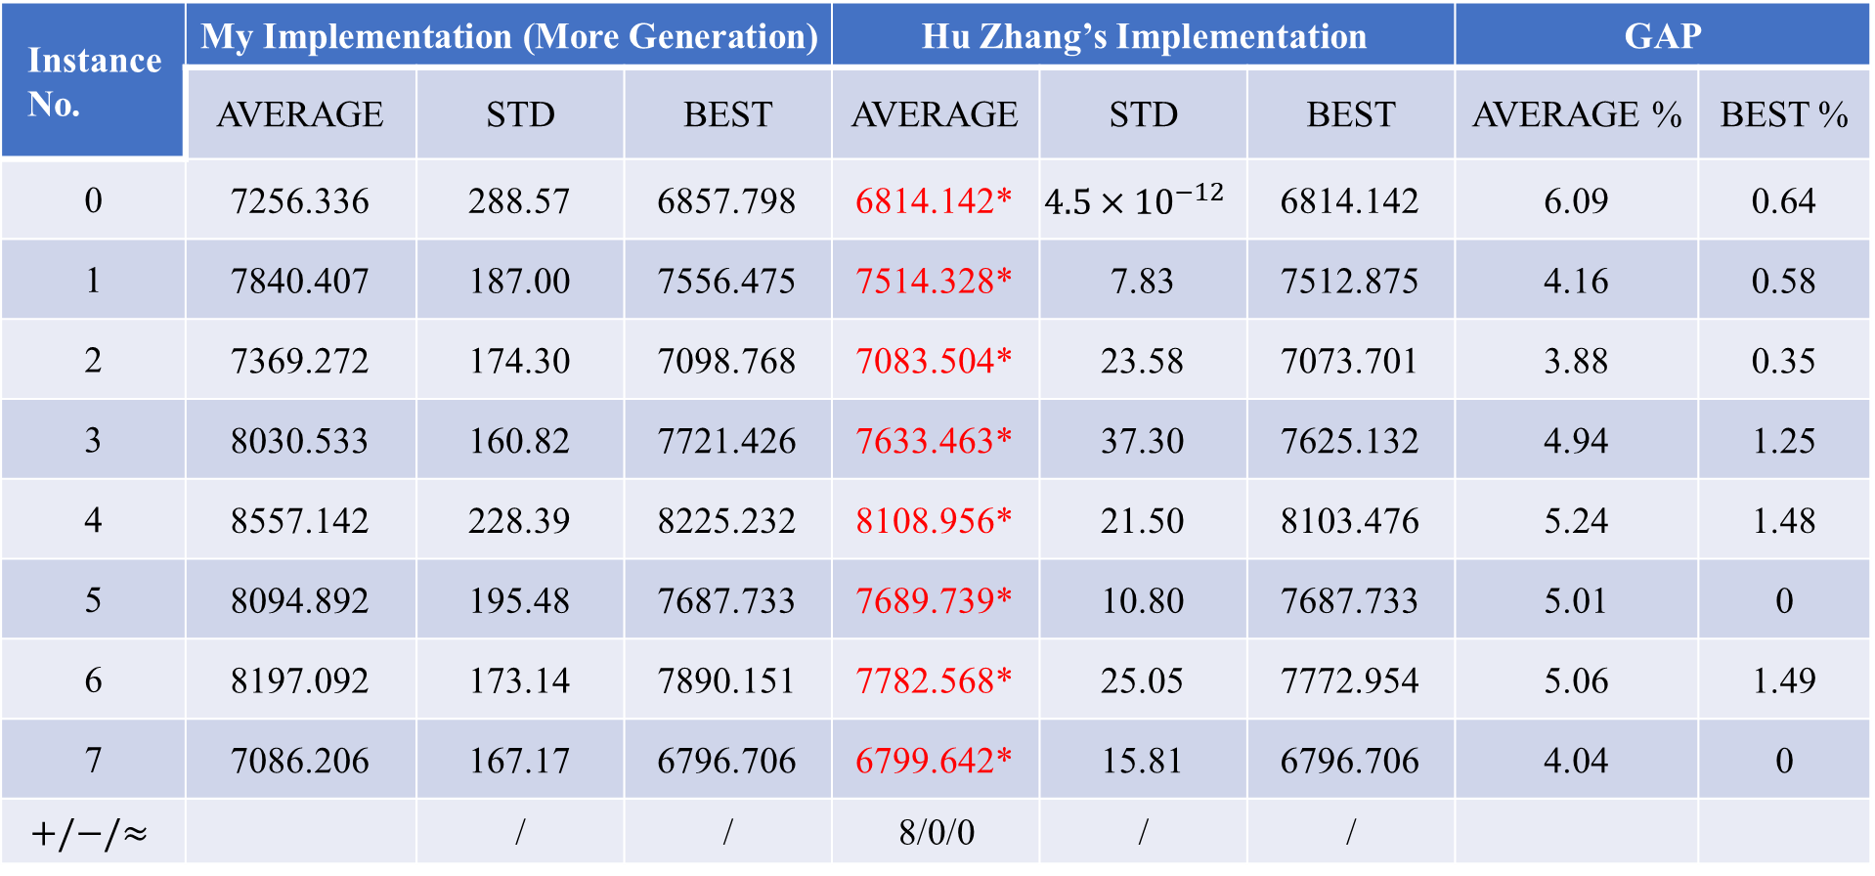
Reproduction Result of EAMLS:
50 nodes instances:
Instance No. | My Implementation (More Generation) |  |  | Hu Zhang’s Implementation |  |  | GAP
 | AVERAGE | STD | BEST | AVERAGE | STD | BEST | AVERAGE % | BEST %
0 | 7256.336 | 288.57 | 6857.798 | 6814.142* | $$4.5×{10}^{−12}$$ | 6814.142 | 6.09 | 0.64
1 | 7840.407 | 187.00 | 7556.475 | 7514.328* | 7.83 | 7512.875 | 4.16 | 0.58
2 | 7369.272 | 174.30 | 7098.768 | 7083.504* | 23.58 | 7073.701 | 3.88 | 0.35
3 | 8030.533 | 160.82 | 7721.426 | 7633.463* | 37.30 | 7625.132 | 4.94 | 1.25
4 | 8557.142 | 228.39 | 8225.232 | 8108.956* | 21.50 | 8103.476 | 5.24 | 1.48
5 | 8094.892 | 195.48 | 7687.733 | 7689.739* | 10.80 | 7687.733 | 5.01 | 0
6 | 8197.092 | 173.14 | 7890.151 | 7782.568* | 25.05 | 7772.954 | 5.06 | 1.49
7 | 7086.206 | 167.17 | 6796.706 | 6799.642* | 15.81 | 6796.706 | 4.04 | 0
$$+/−/≈$$ |  | / | / | 8/0/0 | / | /

Slide 8
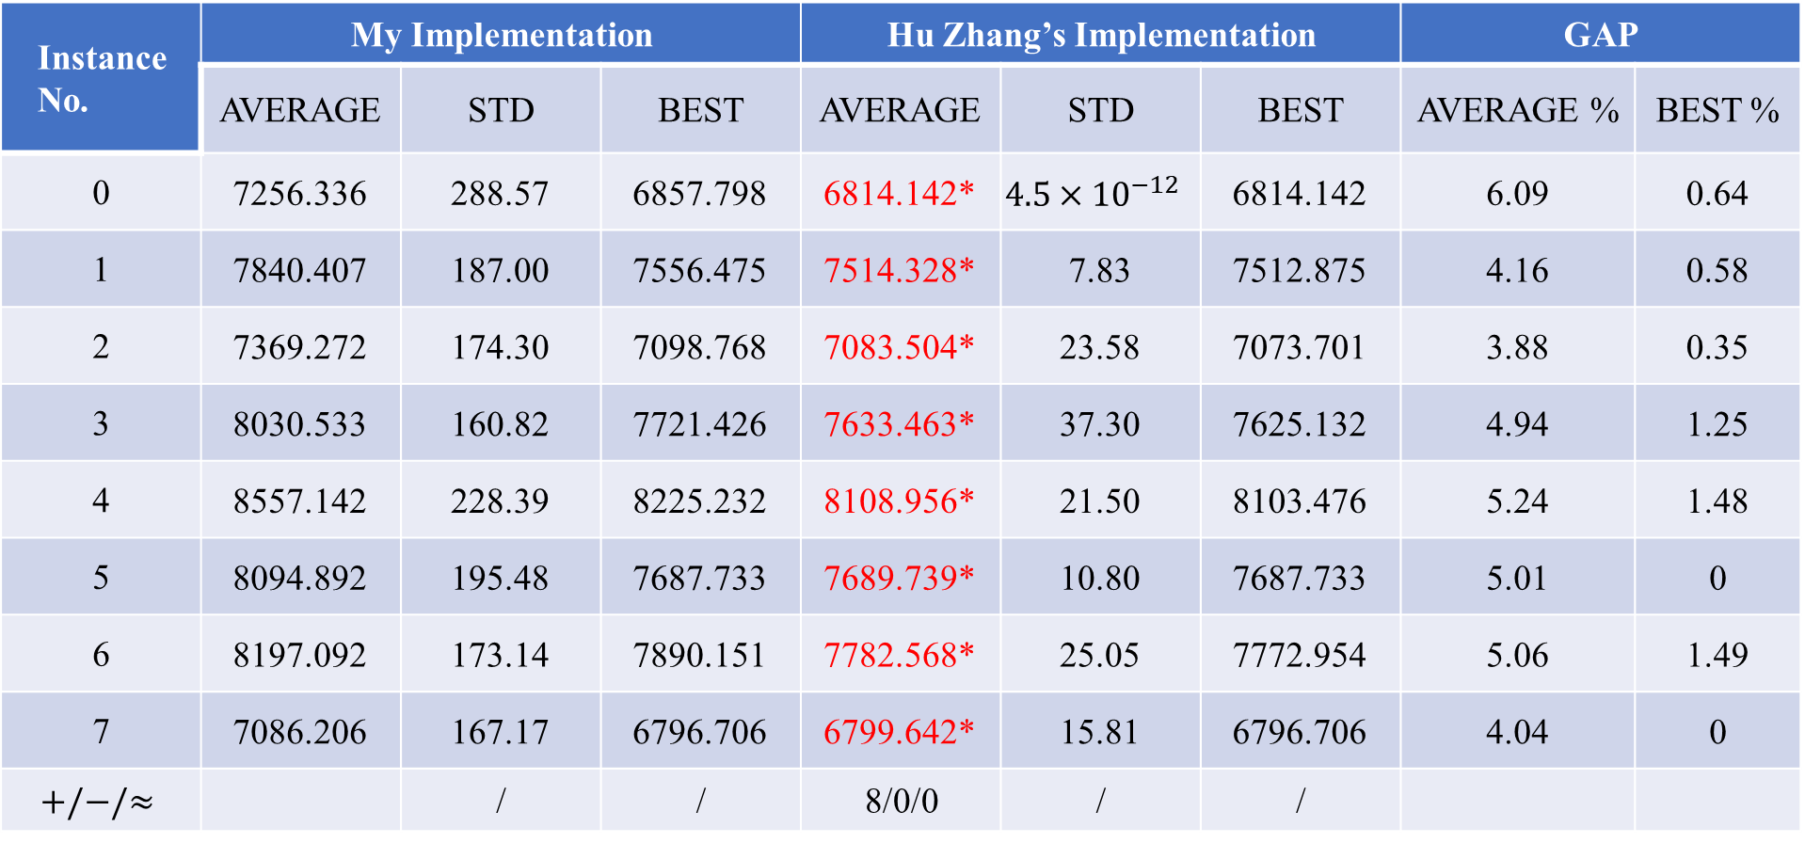
Reproduction Result of EAMLS:
50 nodes instances:
Instance No. | My Implementation |  |  | Hu Zhang’s Implementation |  |  | GAP
 | AVERAGE | STD | BEST | AVERAGE | STD | BEST | AVERAGE % | BEST %
0 | 7256.336 | 288.57 | 6857.798 | 6814.142* | $$4.5×{10}^{−12}$$ | 6814.142 | 6.09 | 0.64
1 | 7840.407 | 187.00 | 7556.475 | 7514.328* | 7.83 | 7512.875 | 4.16 | 0.58
2 | 7369.272 | 174.30 | 7098.768 | 7083.504* | 23.58 | 7073.701 | 3.88 | 0.35
3 | 8030.533 | 160.82 | 7721.426 | 7633.463* | 37.30 | 7625.132 | 4.94 | 1.25
4 | 8557.142 | 228.39 | 8225.232 | 8108.956* | 21.50 | 8103.476 | 5.24 | 1.48
5 | 8094.892 | 195.48 | 7687.733 | 7689.739* | 10.80 | 7687.733 | 5.01 | 0
6 | 8197.092 | 173.14 | 7890.151 | 7782.568* | 25.05 | 7772.954 | 5.06 | 1.49
7 | 7086.206 | 167.17 | 6796.706 | 6799.642* | 15.81 | 6796.706 | 4.04 | 0
$$+/−/≈$$ |  | / | / | 8/0/0 | / | /

